Slide 1
General Business Terms
These are the Business Terms you will need to understand before we start to create our business plan and run our business.

Slide 2
Your Terms
Please get your General Business Terms out so we can discuss them as a class and understand the importance of each

Slide 3
Business
What is Business
An organization or economic system where goods and services are exchanged for one another or for money. – BusinessDictionary.com
Any type of trade is considered business
Different types of business

Slide 4
Business Goals
They are describe what a company expects to accomplish throughout the year.

Slide 5
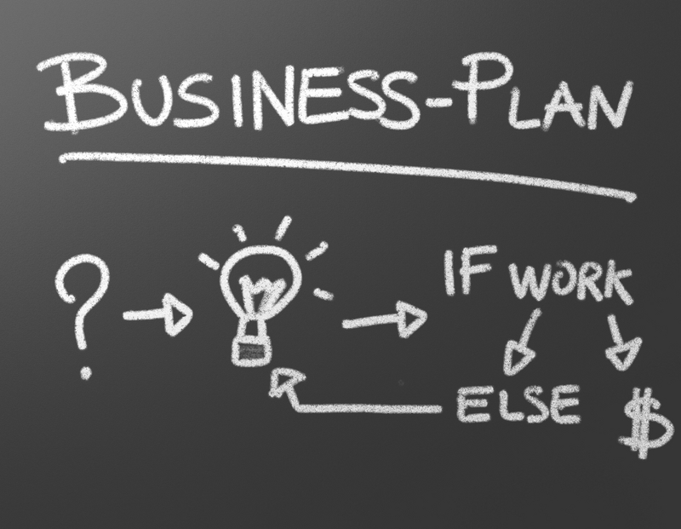
Business Plan
What is a Business Plan?
A written document that describes in detail how a new business is going to achieve its goals. A business plan will lay out a written plan from a marketing, financial and operational viewpoint.

Slide 6
Company Logo and Company Slogan
Logo
Slogan
A recognizable graphic design element, often including a name, symbol or trademark, representing an organization or product . Before you start thinking about designing a business card or picking colors for your letterhead, you need a logo.
a short phrase that serves as a very brief representation of a product or company.
Just Do It
It’s Finger Lickin’ Good
I’m Lovin It
Taste the Rainbow
Eat fresh
We’re magically delicious.

Slide 7
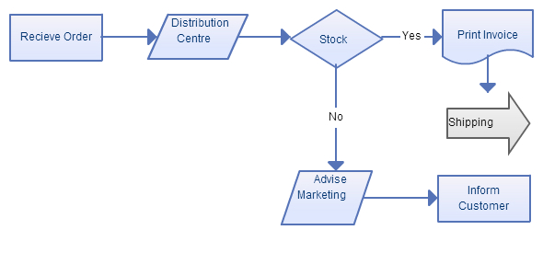
Work Flow Diagram
A workflow diagram visualizes how tasks will flow between resources, whether they're machines or people and what conditions allow the sequence to move forward.

Slide 8
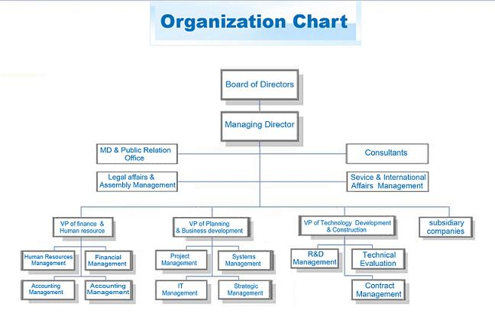
Organizational Chart
An organizational chart (often called organization chart, org chart, organigram(me), or organogram) is a diagram that shows the structure of an organization and the relationships and relative ranks of its parts and positions/jobs.

Slide 9
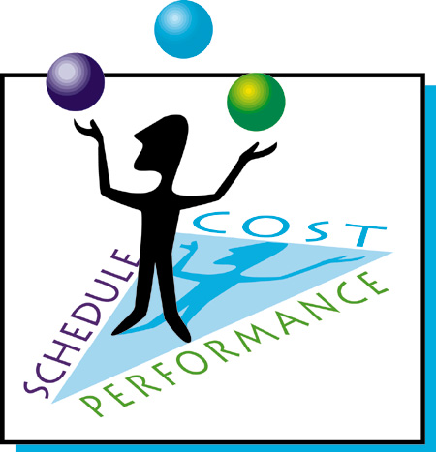
Management
What is management?
the process of dealing with or controlling things or people.

Slide 10
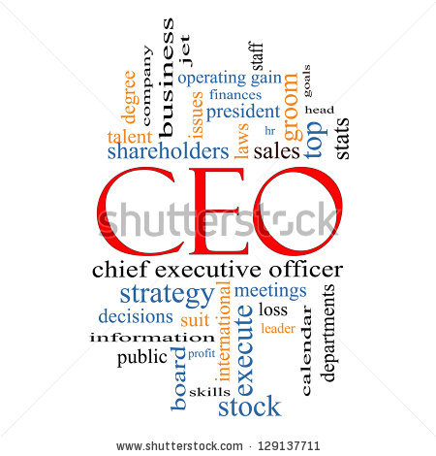
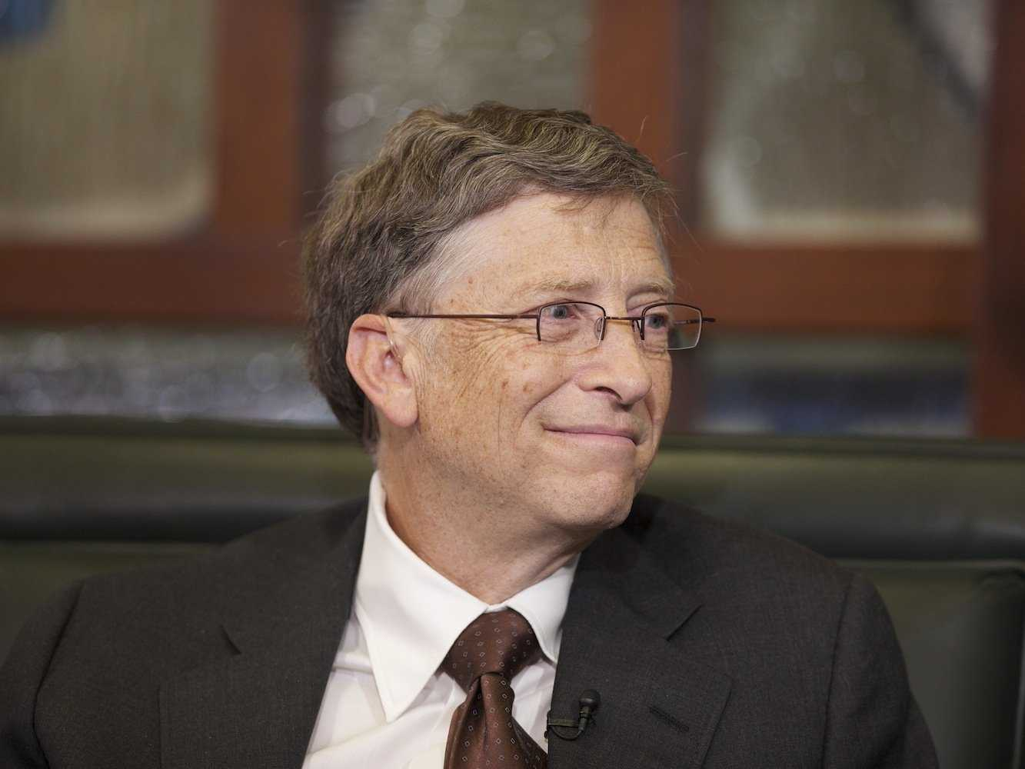
Chief Executive Officer:
What is a Chief Executive Officer? CEO
a top-ranking corporate position, responsible for overseeing operations. Often the company's president, the CEO reports to the chairman of the board and board members.

Slide 11
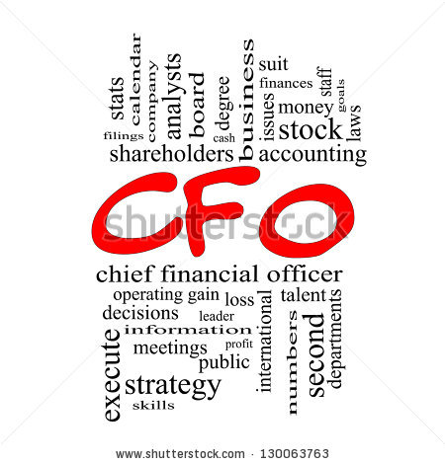
Chief Financial Officer:
What is a Chief Financial Officer? CFO
The chief financial officer (CFO) or chief financial and operatingofficer (CFOO) is a corporate officer primarily responsible for managing the financial risks of the corporation. This officer is also responsible for financial planning and record-keeping, as well as financial reporting to higher management.

Slide 12
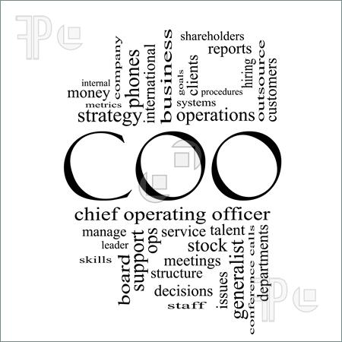
Chief Operating Officer
What is a Chief Operating officer?
A Chief Operating Officer (COO) is the corporate executive who oversees ongoing business operations within the company. The COOreports to the CEO (Chief Executive Officer) and is usually second-in-command within the company.

Slide 13
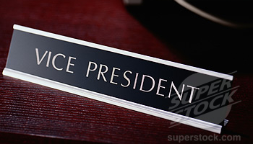
Department Vice Presidents
an official or executive ranking below Chief Executive Officer

Slide 14
Business Departments
Human Resource
A human resources department is a critical component of employee well-being in any business, no matter how small. HR responsibilities include payroll, benefits, hiring, firing, and keeping up to date with state and federal tax laws.
IT Department
Information technology (IT) is the application of computers and telecommunications equipment to store, retrieve, transmit and manipulate data, often in the context of a business or other enterprise.
Administration Department
Office administration is a set of day-to-day activities related to financial planning, billing and recordkeeping, personnel, and physical distribution and logistics, within an organization. An employee that undertakes these activities is commonly called an office administratoror office manager.
Marketing Department
the department of a commercial organization that deals with the marketing of products
Sales Department
the division of a business that is responsible for selling products or services.
Accounting Department
An accounting department provides accounting services and financial support to the organization it belongs to. The department records accounts payable and receivable, inventory, payroll, fixed assets and all other financial elements.

Slide 15
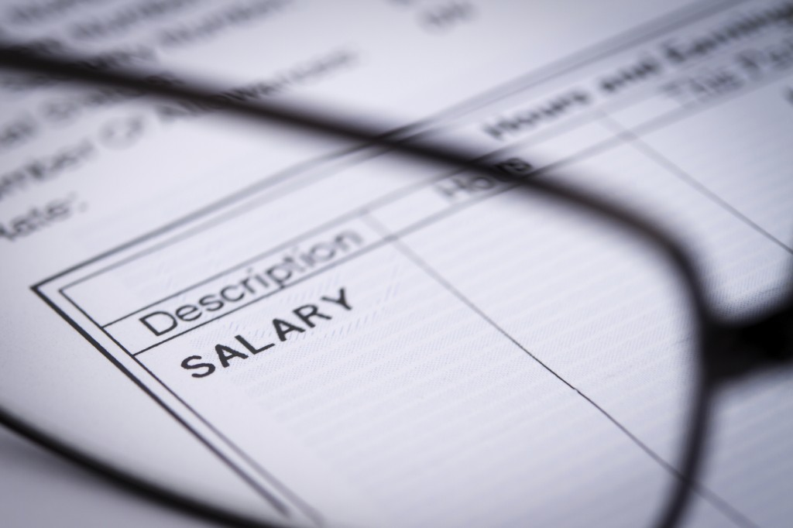
Payroll
a list of a company's employees and the amount of money they are to be paid.

Slide 16
Liability
a thing for which someone is responsible, especially a debt or financial obligation.

Slide 17
Business Documents
Memo
Agenda
a written message, especially in business.
a list of items to be discussed at a formal meeting.
Business Letter
Meeting Minutes
a formal type of communication that is usually typed on 8 1/2 by 11-inch white stationery paper. Business letters must be targeted to a specific individual or group, have a clear and concise purpose, be convincing and end with a specific objective, like a meeting date
the instant written record of a meeting or hearing. They typically describe the events of the meeting, starting with a list of attendees, a statement of the issues considered by the participants, and related responses or decisions for the issues.

Slide 18
Timeline- First Six Weeks
Orientation & Training
Determine firm, product line, slogan, logo
Research competitors
Write Business Plan
Prepare job application and resume
Interview for positions
Begin creating your portfolio

Slide 19
Timeline
Next 6 weeks
Business Plan/TN Trade Fair
Submit Business Plan to Tennessee office
Secure business sponsorship
Begin fundraising
Prep materials for the Trade Fair
Practice departmental responsibilities
Open website

Slide 20
Entrepreneur:
What is Entrepreneur?
a person who organizes and operates a business or businesses, taking on greater than normal financial risks in order to do so.
Now we are going to watch a Video about having an Entrepreneurial Mindset and Visionaries

